Slide 1
Distinguishing Between Renewable and Non-Renewable Energy Resources
Understanding Vancouver's Energy Landscape

Slide 2
CONTENT
Distinguishing Between Renewable and Non-Renewable Energy Resources
Energy Sources in Vancouver
Transition to Renewable Energy
Local Strategies for Sustainable Energy
Acknowledgments

Slide 3
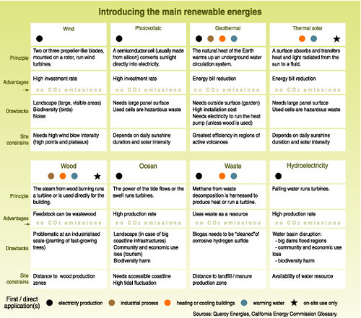
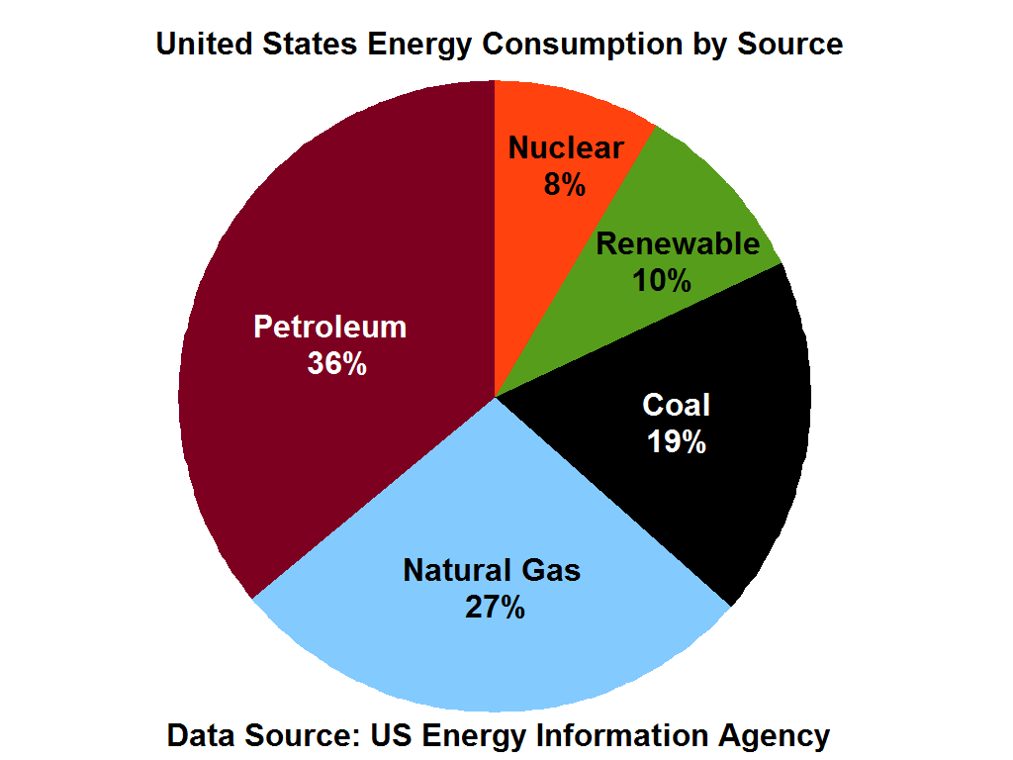
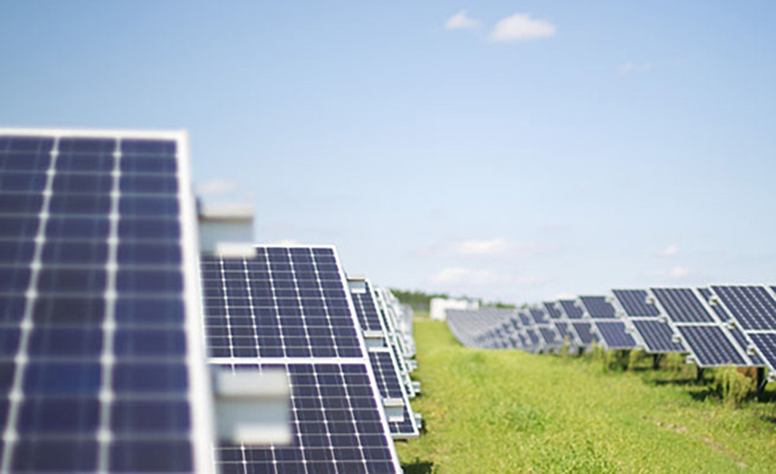
Distinguishing Between Renewable and Non-Renewable Energy Resources
Renewable Energy
Renewable energy sources are those that can be naturally replenished, such as solar, wind, hydro, and geothermal energy. These sources are abundant and environmentally friendly.
Non-Renewable Energy
Non-renewable energy sources include fossil fuels like coal, oil, and natural gas. These resources are finite and contribute to air pollution and climate change.
Unedited image of renewable energy chart from GRID-Arendal’s “Introducing the main renewable energies” on Flickr
License: https://creativecommons.org/licenses/by-nc-sa/2.0/
Unedited image of solar panels from The Johnny Green’s “Solar Farms: A Great Source of Renewable Energy with Some Downside” by Lilly Rubeck
License: https://creativecommons.org/licenses/by-nc-nd/2.5/

Slide 4
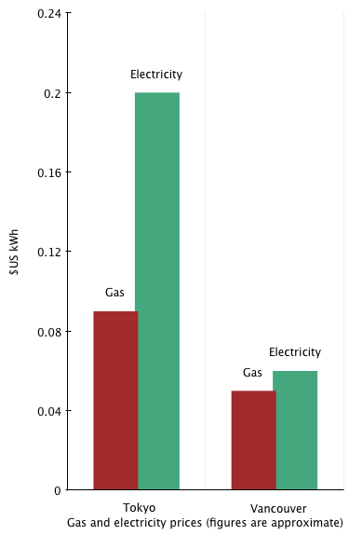
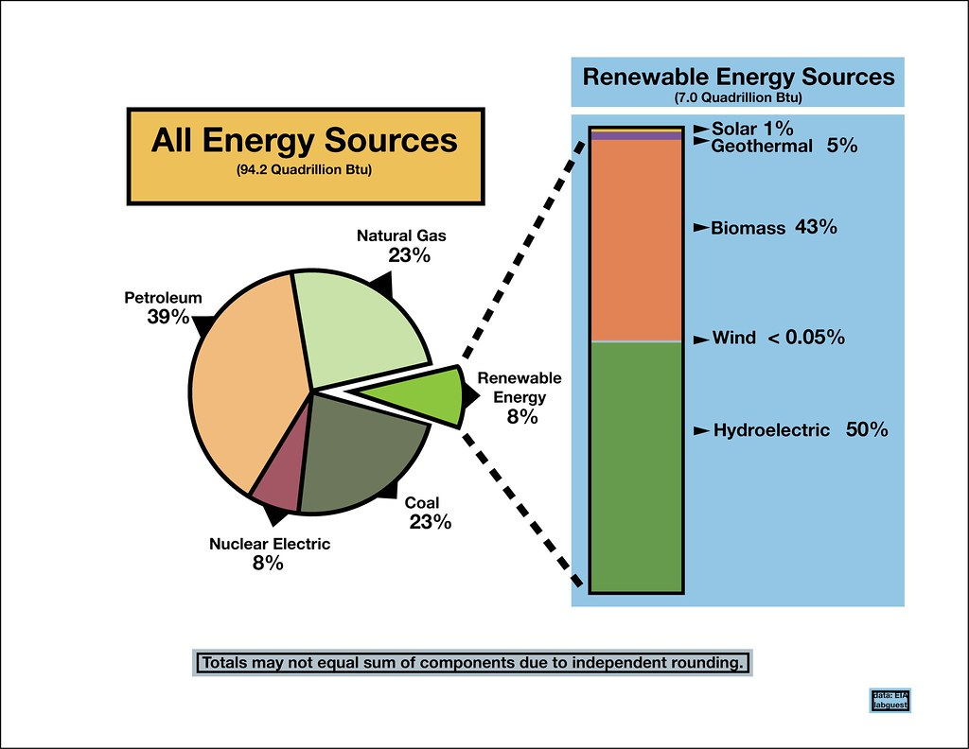
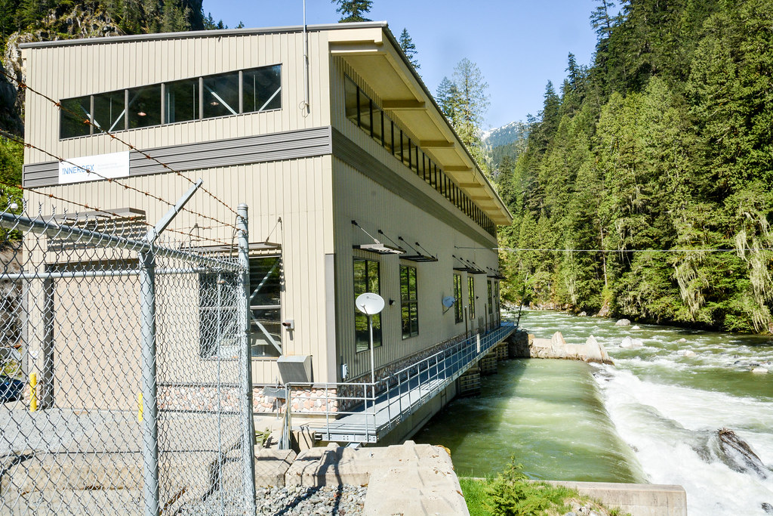
Energy Sources in Vancouver
Hydroelectric Power
Vancouver relies heavily on hydroelectric power, generated primarily from dams on nearby rivers. This clean energy source accounts for a significant portion of the city's electricity needs.
Natural Gas
While Vancouver has made strides in renewable energy, natural gas still plays a role in heating homes and powering industries. Efforts are underway to transition away from this non-renewable resource.
Unedited image of U.S. energy sources pie chart from Zachary Veach’s “U.S. Renewable Energy Statistics” on Flickr
License: https://creativecommons.org/licenses/by-nc-sa/2.0/
Unedited image of gas and electricity prices bar graphs from Bilby on Wikimedia Commons
License: https://creativecommons.org/licenses/by-sa/3.0/
Unedited image of hydroelectric power plant from Pembina Institute’s “Innergex Renewable Energy's Ashlu Creek run-of-river hydroelectric power plant, northwest of Squamish, B.C.” on Flickr
License: https://creativecommons.org/licenses/by-nc-nd/2.0/

Slide 5
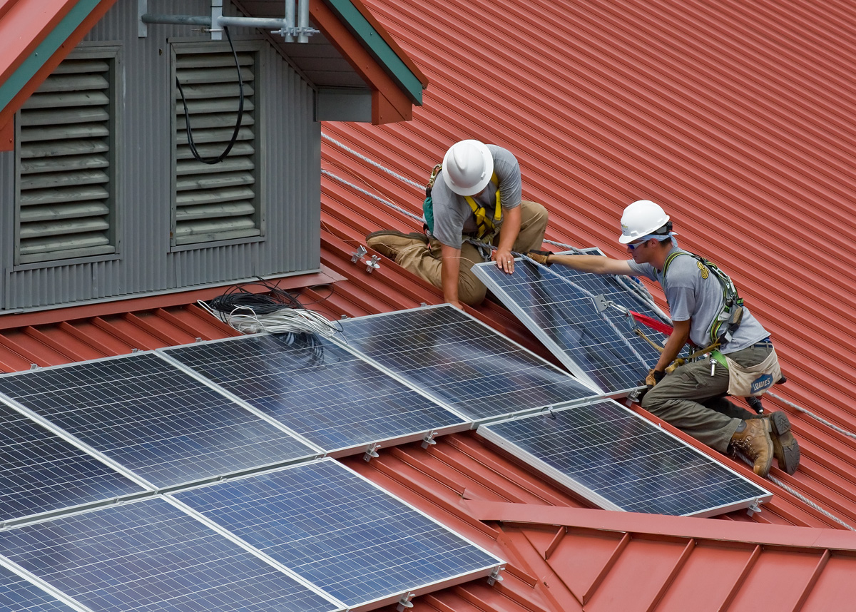
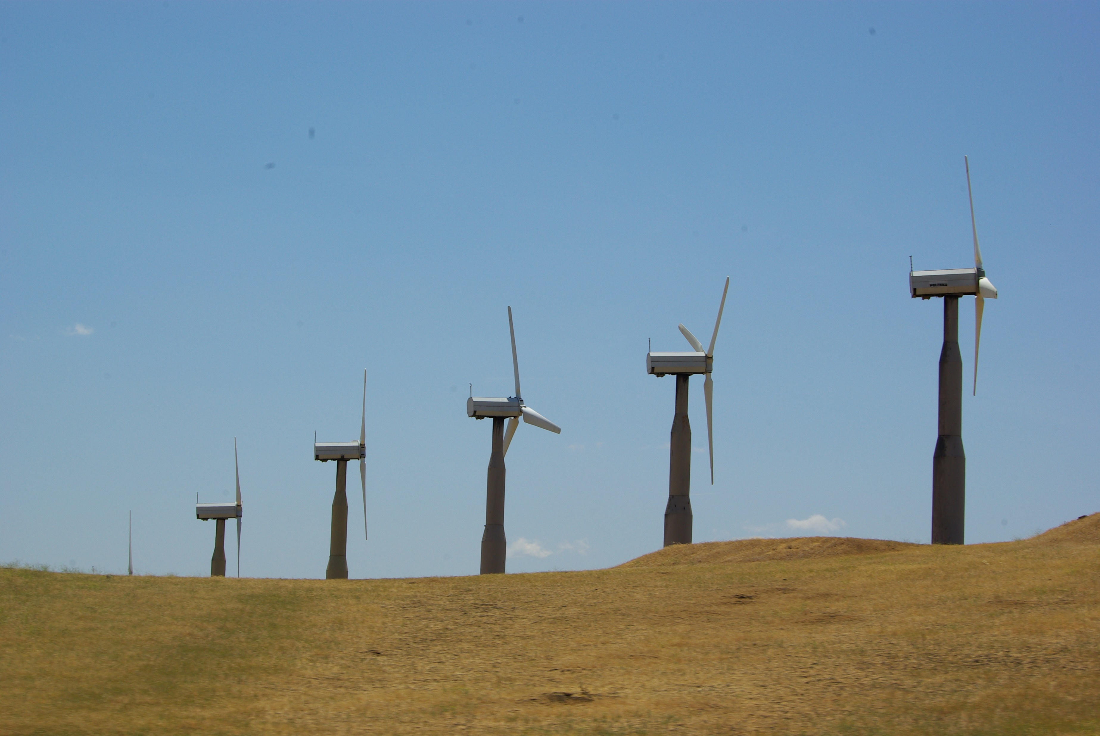
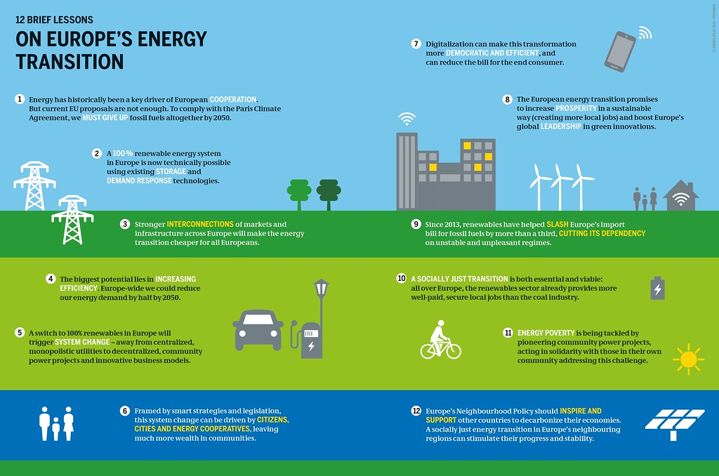
Transition to Renewable Energy
Solar Energy
The adoption of solar energy systems is increasing in Vancouver, particularly for residential and commercial properties. Solar panels harness sunlight to generate electricity, reducing reliance on fossil fuels.
Wind Energy
Vancouver's coastal location makes it well-suited for wind energy generation. Wind turbines installed in strategic locations harness the power of the wind to produce clean electricity for the city.
Unedited image of wind turbines from Altamont Pass Wind Turbines on Wikimedia Commons, by David J Laporte
License: https://creativecommons.org/licenses/by/2.0/
Unedited image of wind turbines from Heinrich-Böll-Stiftung’s “12 BRIEF LESSONS ON EUROPE’S ENERGY TRANSITION” on Flickr
License: https://creativecommons.org/licenses/by/2.0/
Unedited image of solar panel installation uploaded to Wikimedia Commons by AlbertHerring from Wayne National Forest Solar Pane Construction
License: https://creativecommons.org/licenses/by/2.0/

Slide 6
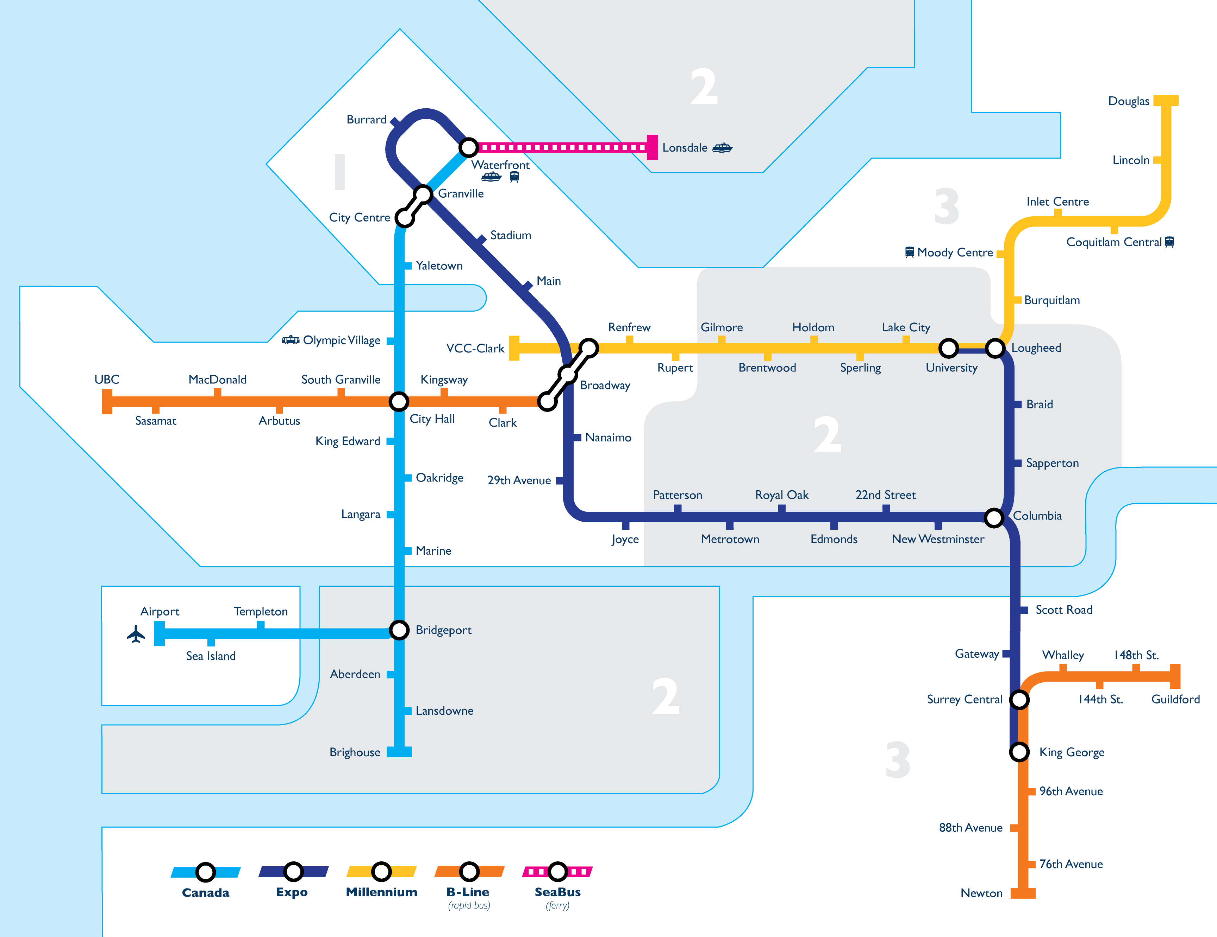
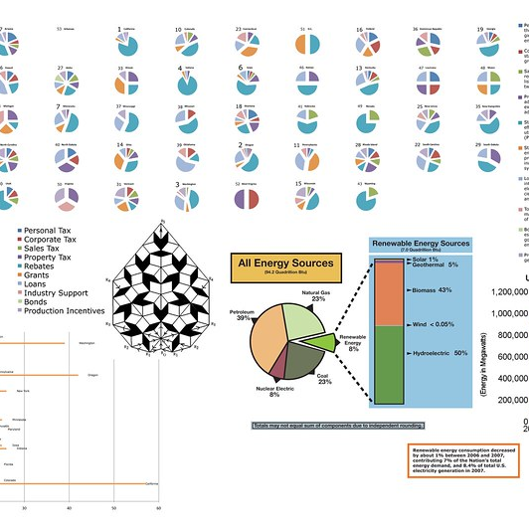
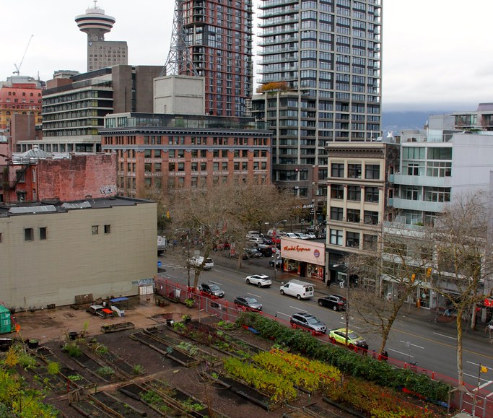
Local Strategies for Sustainable Energy
Decreasing Energy Use
Initiatives promoting energy efficiency in buildings and transportation aim to reduce overall energy consumption in Vancouver. This includes retrofitting buildings with energy-efficient technologies and promoting public transit.
Increasing Renewable Energy Use
Incentives and policies support the adoption of renewable energy technologies, such as rooftop solar panels and community solar projects. These efforts contribute to a more sustainable energy future for Vancouver.
Increasing Renewable Energy Supply
Investments in renewable energy infrastructure, such as expanding hydroelectric capacity and exploring tidal energy options, aim to increase the supply of clean energy in Vancouver and reduce dependence on fossil fuels.
Unedited image of statistical figures from Zachary Veach’s “renewable energy incentive programs statistics” on Flickr
License: https://creativecommons.org/licenses/by-nc-sa/2.0/
Unedited image of Vancouver Transit Network by Paul Wittal on Wikimedia Commons
License: https://creativecommons.org/licenses/by-sa/4.0/
Unedited image of downtown Vancouver from Green Energy Futures’ “Vancouver’s Downtown eastside” on Flickr
License: https://creativecommons.org/licenses/by-nc-sa/2.0/

Slide 7



Acknowledgments
Unedited image of UK and US spellings of “acknowledgement” from Krista Grace Morris’s “Acknowledgement or Acknowledgment?: The Correct Spelling” on INK
License: https://creativecommons.org/licenses/by-nc/4.0/

